Slide 1


From Concept to Code: AWS Data Engineering and ML in Action

Slide 2

Raise Your Hand if…
Promise: By the end of todays workshop, you’ll be more interested with machine learning/data engineering

Slide 3

About Me
Passed the Data Engineer exam with a 93%
2X AWS Certified
Created a Full Stack Website
Author of Master in 30 Days: AWS Certified Data Engineer

Slide 4





Agenda
Difficulty
Data Engineering: Fundamentals and Storage
Data Engineering: Databases
Data Engineering: ETL
Machine learning
Break
Workshop
Bryant Pollard
© All Rights Reserved

Slide 5
10 Things You Will Learn
Data Engineering Fundamentals
Cloud Object Storage: Amazon S3
NoSQL Database: Amazon DynamoDB
ETL: AWS Glue
Machine Learning Fundamentals
Feature Engineering: Fundamentals, Interquartile range, KNN Imputer, VIF
Data Splitting
Hyperparameters and Parameters
Algorithms: Decision Trees and Random Forest
Evaluation Confusion Matrix and ROC

Slide 6
Setup
GitHub:
Machine Learning:
Login to Kaggle or create an account.
Find my profile:
Type in search bar: bryantpollardii
Click on my profile
Find notebook named: WorkshopCodeStockClassifier under “code” tab in my profile.
Steps to find:
Search: bryantpollardii in GitHub
Find workshopProd by clicking my profile and clicking “Repositories”.
You now have access to:
Kaggle code (to follow along in the workshop refer to information on the right)
Glue code
PowerPoint Slides
Recording of todays session

Slide 7
Expectations
This is a hard workshop, don’t fear since this may open gates of opportunity.
Since this is a hard workshop, it is preferred to have some, but not a lot, of prerequisite knowledge.
I strongly suggest to get a notebook out and take notes.

Slide 8


Data Engineering: Fundamentals and Storage

Slide 9









Data Engineering Overview
Data Sources
What you can do with this data
Data storage/database
Databases
Data pipeline
Analyze
Web applications
Storage
Visualize
Files
Machine learning

Slide 10
Data Maintenance
Data engineers ensure data quality by looking at:
Accuracy and Consistency
Data engineers maintain:
Pipelines, Infrastructure, Performance, and Security
Bryant Pollard
© All Rights Reserved

Slide 11










Amazon S3
Amazon Simple Storage Service (Amazon S3) uses buckets as storage containers for “objects”.
Objects are files that are stored inside S3.
Machine Learning
Data
Amazon S3
AWS Glue
Amazon S3
Amazon Athena
Bryant Pollard
© All Rights Reserved
AWS Glue
Amazon Redshift

Slide 12
10 Things You Will Learn
Data Engineering Fundamentals
Cloud Object Storage: Amazon S3
NoSQL Database: Amazon DynamoDB
ETL: AWS Glue
Machine Learning Fundamentals
Feature Engineering: Fundamentals, Interquartile range, KNN Imputer, VIF
Data Splitting
Hyperparameters and Parameters
Algorithms: Decision Trees and Random Forest
Evaluation Confusion Matrix and ROC

Slide 13

Databases
Partition 1
Partition 2
.
.
.
Partition N

Slide 14
NoSQL
Compatible
DynamoDB
Schemaless
Items don’t require the same set of attributes.
Add new attributes on the fly.
Querying
PartiQL (similar to SQL)
Partitioning
Distributes data across physical resources (horizontal scaling)

Slide 15
DynamoDB Table Structure
There are two main ways to design your table in DynamoDB:
multi-table – Similar to traditional style of storing data in databases (relational).
single-table –This design keeps all core objects in a single table, with related items stored in partitions based on their respective data categories.
.
.
.
Bryant Pollard
© All Rights Reserved

Slide 16

DynamoDB Design
Table
Table – This is where the data is stored, consisting of items.
Item – This is essentially the rows of the table.
Attribute – These are essentially the columns of the table.
Items
Items
Attributes
Attributes
Bryant Pollard
© All Rights Reserved

Slide 17
DynamoDB Design
Partition 1
The underlying design of DynamoDB uses partitions to store data.
This is how DynamoDB scales
Partition 2
Put request
Partition 3
Amazon DynamoDB
Partition 4
Bryant Pollard
© All Rights Reserved

Slide 18
DynamoDB Partition Key (PK)
This is a required key that uniquely identifies the table. It essentially serves as the index on the table, enabling querying capabilities.
It is crucial to determine the best partition key based on the access patterns of the applications using the table.
PK | Attribute | Attribute
Item
Item
Item
Bryant Pollard
© All Rights Reserved

Slide 19
DynamoDB Sort Key (SK)
For each partition key, there can be multiple items.
The SK is specific to each item.
Used to sort the items for the partition key to accelerate data retrieval of an item collection.
PK
SK | Attribute
Bryant Pollard
© All Rights Reserved

Slide 20
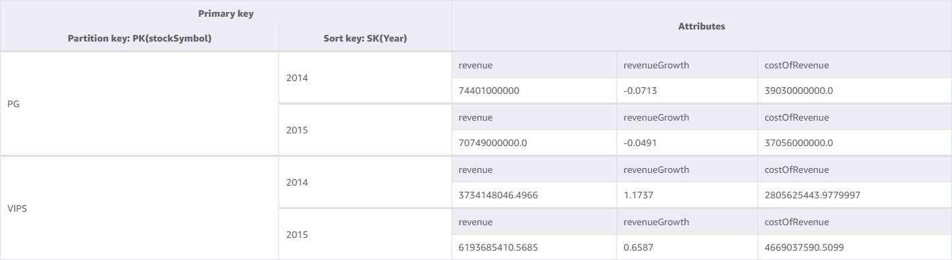
Bryant Pollard
© All Rights Reserved

Slide 21
10 Things You Will Learn
Data Engineering Fundamentals
Cloud Object Storage: Amazon S3
NoSQL Database: Amazon DynamoDB
ETL: AWS Glue
Machine Learning Fundamentals
Feature Engineering: Fundamentals, Interquartile range, KNN Imputer, VIF
Data Splitting
Hyperparameters and Parameters
Algorithms: Decision Trees and Random Forest
Evaluation Confusion Matrix and ROC

Slide 22


Data Engineering: ETL
ETL

Slide 23


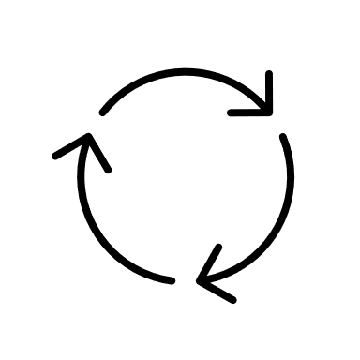
Extract
Transform
Load
AWS Cloud
Bryant Pollard
© All Rights Reserved

Slide 24
Apache spark + AWS Glue
Apache spark is an open-source computing device, optimized for big data.
AWS Glue runs on top of Apache Spark
Use cases:
Creating ETL workflows
Analyzing log data
Discovering and Cataloging data
Data Processing and analysis
Machine Learning
Real-time processing and insight
Graph processing

Slide 25
AWS Glue Job
Glue ETL Job

Slide 26
AWS Glue ETL Jobs
ETL Jobs – These are for ETL operations. Requiring data source and target.
A script/notebook defines these operations which can be defined through AWS-generated ETL code or create custom scripts/notebooks for complex jobs.

Slide 27
Glue DynamicFrames
Like an Apache spark DataFrame, but DynamicFrames can handle massive amounts of data.
In the workshop I will commonly switch between the two.
This is what stores the data temporarily.
join – Joins DynamicFrames
map – Apply some function to a DynamicFrame
apply_mapping – change column names/data type.
SO much more!
Coalesce (Spark function)
Year | 2015 price variance | 2016 price variance | 2017 price variance
2015 | nan | 15 | nan
2016 | nan | nan | 5
Year | Price variance
2015 | 15
2016 | 5

Slide 28




AWS Cloud
Glue
Glue script/notebook
join
map
apply_mapping
Coalesce
Something else
.
.
.

Slide 29
10 Things You Will Learn
Data Engineering Fundamentals
Cloud Object Storage: Amazon S3
NoSQL Database: Amazon DynamoDB
ETL: AWS Glue
Machine Learning Fundamentals
Feature Engineering: Fundamentals, Interquartile range, KNN Imputer, VIF
Data Splitting
Hyperparameters and Parameters
Algorithms: Decision Trees and Random Forest
Evaluation Confusion Matrix and ROC

Slide 30
Data Engineering Overview
Data Sources
What you can do with this data
Amazon DynamoDB
Databases
Data pipeline
Analyze
Web applications
AWS Glue
Storage
Visualize
Amazon S3
Files
Machine learning

Slide 31
Recap
Data Engineers:
Build ETL pipelines
Maintain accuracy and consistency
Maintain security
Amazon S3:
A Storage system that can store a lot of data at a low cost.
Amazon DynamoDB:
NoSQL database
Can be used as a single table
Data is distributed in partition’s (physical resources)
Consists of items (rows) and attributes (columns).
PK is required and important to understand what the PK should be.
Limited in querying mechanisms, but highly scalable.
Use PartiQL for querying.

Slide 32
Recap
AWS Glue:
ETL (Extract, Transform, Load) service
Uses Apache Spark
Can use a glue script/notebook:
Define data source and target
Define ETL operations through a script, use Apache Spark DataFrames and Glue DynamicFrames for operations.
The Amazon services listed, required computational power:
We do not manage the servers!
We wouldn’t want to perform big data ETL operations locally, if even possible!

Slide 33
Questions? I will only take 3 at this time

Slide 34


Machine Learning
Feature engineering
Data splitting
Training the algorithm
…
Once ready for deployment
Full-stack application with AI
Evaluation

Slide 35










Why Data is Relevant to Machine Learning Engineers
Machine Learning Overview
Feature
Engineering
Machine Learning
Problem
Model Design
Model Design
Optimization
Optimization
Idea
Deploy
Idea
Data Collection
Model Training
Model Testing
Model Training
Model Testing
Data Transformation
Data Analysis
Bryant Pollard
© All Rights Reserved

Slide 36
Artificial Intelligence
Deep Learning
Machine Learning
Generative AI
Bryant Pollard
© All Rights Reserved

Slide 37
Supervised vs Unsupervised Learning
Supervised | Unsupervised
Data is labeled | Data isn't labeled
Uses the labeled data to train the model | Uses the unlabeled data to discover patterns on its own.
Bryant Pollard
© All Rights Reserved

Slide 38
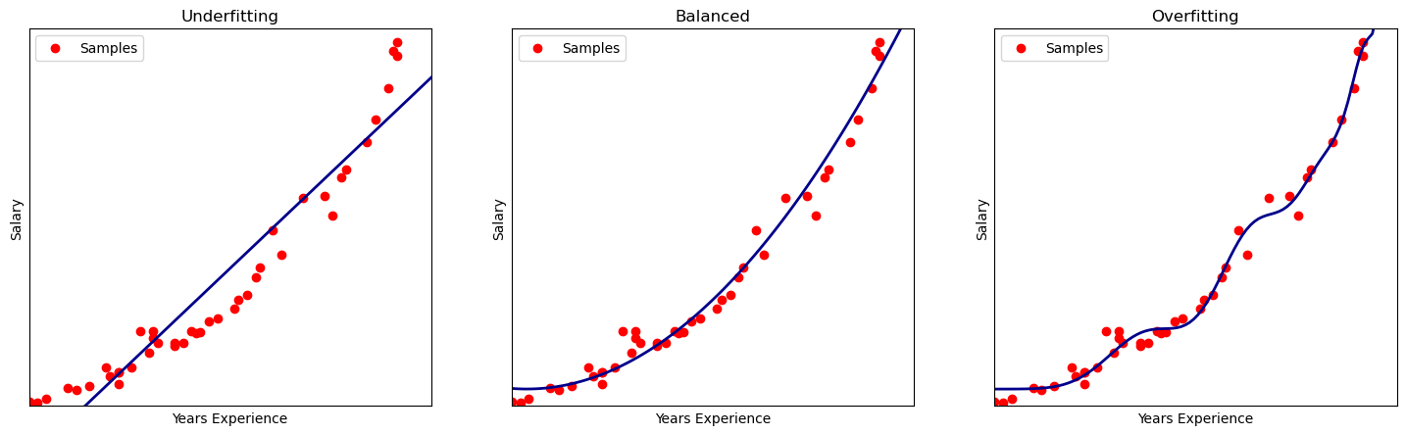
Fitting
Missing the trend
More general fitting
Best performance

Slide 39
10 Things You Will Learn
Data Engineering Fundamentals
Cloud Object Storage: Amazon S3
NoSQL Database: Amazon DynamoDB
ETL: AWS Glue
Machine Learning Fundamentals
Feature Engineering: Fundamentals, Interquartile range, KNN Imputer, VIF
Data Splitting
Hyperparameters and Parameters
Algorithms: Decision Trees and Random Forest
Evaluation Confusion Matrix and ROC

Slide 40
Feature Engineering: Basics
Missing Data
Dropping the row/feature
Imputation:
Statistical:
Mean
Median
Machine Learning:
Regression
KNN
Outliers
Interquartile Range
Several other techniques:
Machine Learning
Statistical
Feature Transformation
Scaling
Encoding
Binning
Shuffling
Feature Selection
VIF
ANOVA F-score
Several other techniques:
Dimensionality Reduction, statistical, wrapper

Slide 41
Feature Engineering: Interquartile Range
Min
25%
50%
75%
Max
Q1
Q2
Q3
Q4
Price Variance
-92 | -28 | -6 | 2 | 4 | 5 | 6 | 7 | 12 | 14 | 17 | 19 | 22 | 25 | 27 | 103
-92 | -78 | -6 | 2
3
4 | 5 | 6 | 7
9.5
12 | 14 | 17 | 19
20.5
22 | 25 | 27 | 103
Calculate IQR = Q3-Q1= 20.5 – 3 = 17.5
Calculate lower limit = Q1 – 1.5*IQR
=3-1.5(17.5)
=-23.25
Calculate upper limit = Q3 – 1.5*IQR
= 20.5 + 1.5(17.5)
= 46.75
-92 | -28 | -6 | 2 | 4 | 5 | 6 | 7 | 12 | 14 | 17 | 19 | 22 | 25 | 27 | 103
If x < -23.25
If x > 46.75
Impute median
Impute median

Slide 42
Feature Engineering: KNN Imputer
Uses an algorithm called “K- nearest-neighbors” to impute the missing value.
The process is as follows:
Finds the nearest neighbors to the missing data point
Take the mean/median of these “nearest neighbors”
Hyperparameters:
N_neighbors
Weights
Metric
This is another feature value in the same row as the missing value.
Some Feature
2
1
3
4
.
.
.
Other Features
Feature that contains missing value that we are trying to impute
2
1
3
4

Slide 43


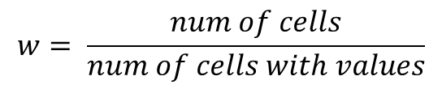
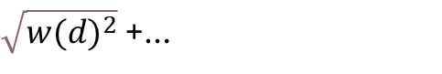
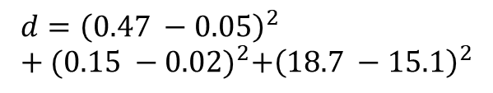
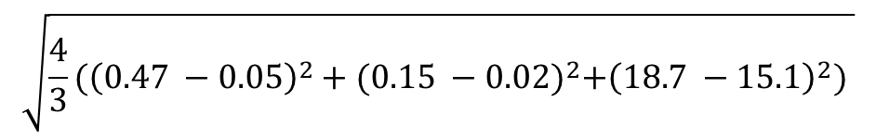
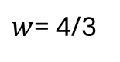
Feature Engineering: KNN Imputer
Dividened per share | Gross Margin | Profit Margin | priceEarningRatio | Marketcap
NaN | 0.47 | 0.15 | 18.7 | -0.11
0.96 | 0.05 | 0.02 | 15.1 | NaN
1.88 | 0.24 | 0.03 | 15.2 | -0.20
0.28 | 0.12 | -0.002 | 0 | -0.49
.
.
.
Calculate the “distances” (use rest of features)
We are comparing
$\sqrt{w{(d)}^{2}}$ +…
$w$= 4/3
$${d=\left(0.47 −0.05\right)}^{2}+{(0.15 −0.02)}^{2}+{\left(18.7 −15.1\right)}^{2}$$
$$d=({value in row −value from different row)}^{2}$$
$$w= \frac{num of cells}{num of cells with values}$$
$$\sqrt{{\frac{4}{3}(\left(0.47 −0.05\right)}^{2}+{(0.15 −0.02)}^{2}+{\left(18.7 −15.1\right)}^{2}) }$$
= 4.187 Next row = 3.510 Next row = 18.707

Slide 44

Dividened per share | Gross Margin | Profit Margin | priceEarningRatio | Marketcap
NaN | 0.47 | 0.15 | 18.7 | -0.11
0.96 | 0.05 | 0.02 | 15.1 | NaN
1.88 | 0.24 | 0.03 | 15.2 | -0.20
0.28 | 0.12 | -0.002 | 0 | -0.49
.
.
.
Comparing first row with
Second row = 4.187
Third row = 3.510
Fourth row = 18.707
.
.
.
Impute the value
Number of neighbors = 2
Find the two lowest values
Take the mean: (0.96 + 1.88)/2 = 1.42

Slide 45
10 Things You Will Learn
Data Engineering Fundamentals
Cloud Object Storage: Amazon S3
NoSQL Database: Amazon DynamoDB
ETL: AWS Glue
Machine Learning Fundamentals
Feature Engineering: Fundamentals, Interquartile range, KNN Imputer, VIF
Data Splitting
Hyperparameters and Parameters
Algorithms: Decision Trees and Random Forest
Evaluation Confusion Matrix and ROC

Slide 46
Validation data (10% of the data)
=
Data
Training data (80% of the data)
Test data (10% of the data)
Bryant Pollard
© All Rights Reserved
Training data (80% of the data)
Test data (20% of the data)

Slide 47

K-Folds Cross Validation
Machine Learning Algorithm
= Validation
Number of data points: 500
= Train
100
100
100
100
100
Metric
Metric
Metric
Metric
Metric
Average
Output

Slide 48
10 Things You Will Learn
Data Engineering Fundamentals
Cloud Object Storage: Amazon S3
NoSQL Database: Amazon DynamoDB
ETL: AWS Glue
Machine Learning Fundamentals
Feature Engineering: Fundamentals, Interquartile range, KNN Imputer, VIF
Data Splitting
Hyperparameters and Parameters
Algorithms: Decision Trees and Random Forest
Evaluation Confusion Matrix and ROC

Slide 49
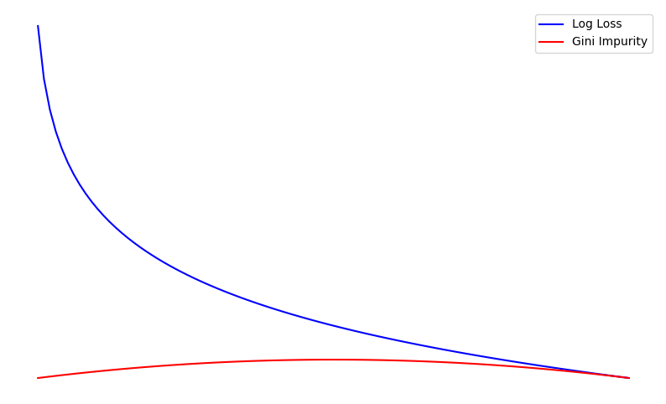

Training Machine Learning Algorithms
Loss
Value To Optimize
Gini impurity

Slide 50
Hyperparameter Tuning
Hyperparameters are the “settings” for the algorithm
They are CRUCIAL for improving your model's performance
There are libraries to optimize hyperparameters.

Slide 51


Difference Between Parameters and Hyperparameters
Hyperparameters:
Parameters:
n_estimators=100,
max_depth=20,
min_samples_split=5,
…
Math values used in training
Full process:
Training
Define Hyperparameters
Evaluate

Slide 52

param_grid = {
'n_estimators’: [25,75],
'max_depth’: [5, 10],
'min_samples_split': [5, 10],
'min_samples_leaf': [2, 4]
}
grid_search = GridSearchCV(…,param_grid, cv=3, …)
Model Combination 1:
'n_estimators’: 25
'max_depth’: 5
'min_samples_split’: 5
'min_samples_leaf': 2
Model Combination 2:
'n_estimators’: 25
'max_depth’: 5
'min_samples_split’: 5
'min_samples_leaf’: 4
Model Combination 3:
'n_estimators’: 25
'max_depth’: 5
'min_samples_split’: 10
'min_samples_leaf': 2
…
K folds cross validation data set
K folds cross validation data set
K folds cross validation data set
Evaluation metrics
Evaluation metrics
Evaluation metrics
Pick the best combination

Slide 53
10 Things You Will Learn
Data Engineering Fundamentals
Cloud Object Storage: Amazon S3
NoSQL Database: Amazon DynamoDB
ETL: AWS Glue
Machine Learning Fundamentals
Feature Engineering: Fundamentals, Interquartile range, KNN Imputer, VIF
Data Splitting
Hyperparameters and Parameters
Algorithms: Decision Trees and Random Forest
Evaluation Confusion Matrix and ROC

Slide 54
ML Algorithm: Decision Trees
Data Point
Root Node
True
False
Internal Node
Internal Node
False
True
False
True
Leaf Node
Internal Node
Leaf Node
Internal Node
True
False
False
Leaf Node
Leaf Node
True
Internal Node
Internal Node
True
False
True
False
Leaf Node
Leaf Node
Leaf Node
Leaf Node

Slide 55
Data Point
Question trying to answer:
Should I go for a run?
ML Algorithm: Decision Trees
Is it raining?
True
False
Don’t go on a run.
Temp > 40
True
False
Temp < 90
Don’t go on a run.
True
False
Humidity < 80%
Don’t go on a run.
True
False
Go on a run.
Don’t go on a run.

Slide 56
Random Forest and Ensemble Methods
Ensemble algorithms – Combine multiple weak learners to make 1 strong learner. In the case of random forest, it uses decision trees.
Random forest uses: Bagging
Bootstrapping – Takes random rows of the dataset, grouping them into subsets. These subsets are the same size and can be the same size as the training dataset.
Aggregating – If this were determining if someone should go on a run or not, going on a run would be true and not going on a run would be false. It then votes using the weak learners for the final prediction.
Note there are different ensemble methods, also note that above is only regarding classification.

Slide 57
Training to make decision trees
…
…
Predicted True | Predicted False
76 | 24
ML Algorithm: Random Forest

Slide 58
10 Things You Will Learn
Data Engineering Fundamentals
Cloud Object Storage: Amazon S3
NoSQL Database: Amazon DynamoDB
ETL: AWS Glue
Machine Learning Fundamentals
Feature Engineering: Fundamentals, Interquartile range, KNN Imputer, VIF
Data Splitting
Hyperparameters and Parameters
Algorithms: Decision Trees and Random Forest
Evaluation Confusion Matrix and ROC

Slide 59
Actual
 | Buy the stock | Don’t buy the stock
Buy the stock | True Positives | False Positives
Don’t buy the stock | False Negatives | True Negatives
Predicted
Bryant Pollard
© All Rights Reserved

Slide 60
Actual
 | Buy the stock | Don’t buy the stock
Buy the stock | 213 | 11 | 224
Don’t buy the stock | 8 | 235 | 243
 | 221 | 246
Predicted
Bryant Pollard
© All Rights Reserved

Slide 61
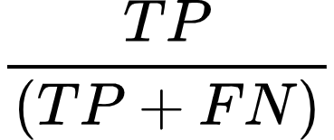
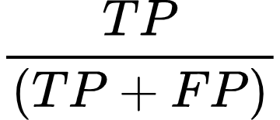
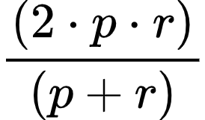
Recall
Precision
F1 Score
Formula
Formula
Formula
Actual
Actual
Prioritize
both as if they are equally important
Actual
Prioritize False Negatives
Prioritize False
Positives
 | Has Cancer | Does Not Have Cancer
Has Cancer | 125 | 8
Does Not Have Cancer | 5 | 235
 | Spam | Not Spam
Spam | 252 | 54
Not spam | 35 | 353
 | Person | Not a Person
Person | 345 | 156
Not a Person | 186 | 275
Predicted
Predicted
Predicted
Calculation
Calculation
Calculation
125/(125+5) = 0.96153…
252/(252+54) = 0.82352…
p = 345/(345 + 156) = 0.688…
Key
r = 345/(345 + 186) = 0.649…
TP = True Positive
FN = False Negatives
FP = False Positive
p = Precision
r = Recall
Plug in (Full number)
((2 * (0.688…)(0.649…))/((0.688…)+(0.649…))
= 0.6686046511627906…

Slide 62
ROC(Receiver Operator Characteristics) and AUC
ROC is another way to evaluate your model.
ROC is a graphical representation comparing the FPR(X) and the TPR(Y)
In classification we must set a threshold to determine what the prediction will be:
Set threshold to 50%:
Predicted True | Predicted False
76 | 24
This has more than 50% of predictions to be “True”.
By definition of our threshold, we classify this as “True”

Slide 63
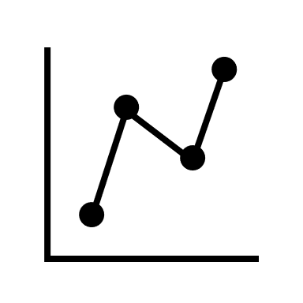
Building a ROC
Set a threshold (on algorithm we are computing this on)
FPR
TPR
Calculate
Plot

Slide 64
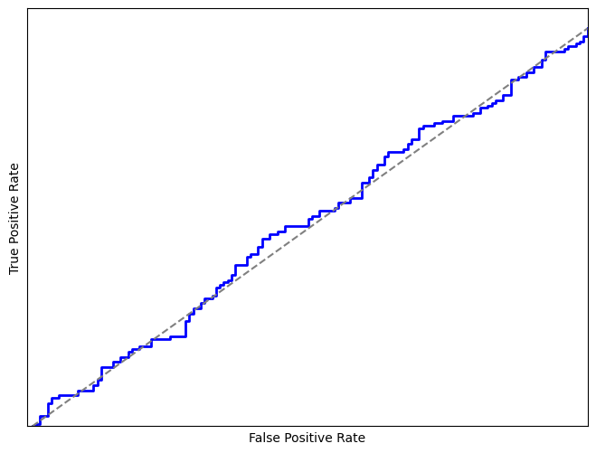
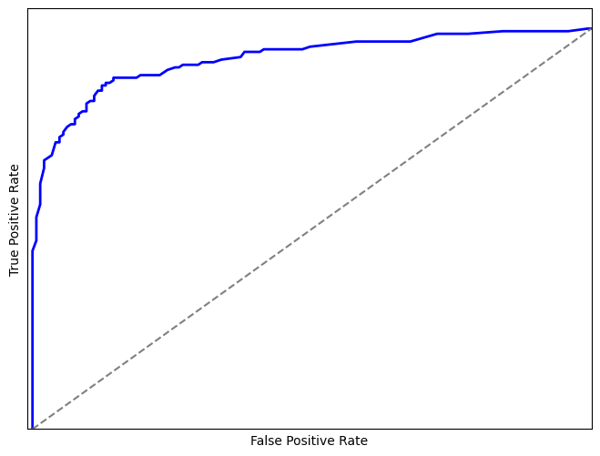
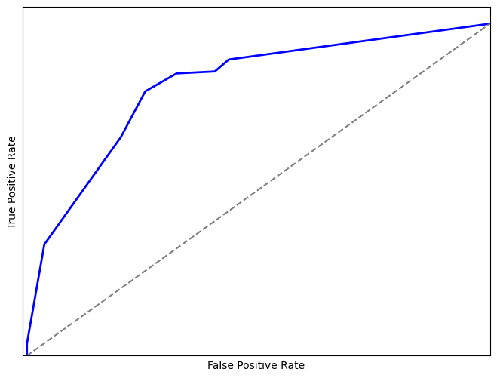

Slide 65
10 Things You Will Learn
Data Engineering Fundamentals
Cloud Object Storage: Amazon S3
NoSQL Database: Amazon DynamoDB
ETL: AWS Glue
Machine Learning Fundamentals
Feature Engineering: Fundamentals, Interquartile range, KNN Imputer, VIF
Data Splitting
Hyperparameters and Parameters
Algorithms: Decision Trees and Random Forest
Evaluation Confusion Matrix and ROC

Slide 66
Questions? I will only take 3 at this time

Slide 67
Break

Slide 68


Let’s Step into the Real world
To optimize glue, you would build a ML pipeline.
Messy company data
ETL
Partition 1
Partition 2
.
.
.
Full-stack application
Feature engineering
Data splitting
Partition N
Training the algorithm
…
Once ready for deployment
Full-stack application with AI
Evaluation
Bryant Pollard
© All Rights Reserved

Slide 69
Introducing My Book
What You Will learn
Fundamentals: Data Engineering, SQL, Git, Security
In depth: Compute, Storage, Databases, Migration, Extracting, transforming, and loading data using data pipelines in the scope of data engineering and machine learning, Streaming data, Querying data, Application integration, Monitoring systems, Security of the cloud, Networking, Engineering tools, and more!
Master the Material in a Month
Colored Diagrams
Practice Exam

Slide 70
Benefits
Acquire relevant skills
Earn a certification
Boost your resume
You can add your certification to your resume. This will get you one step closer to your dream internship and job.

Slide 71
Introducing My Upcoming Book
Advanced Machine Learning concepts
Algorithm section is practically one big, simplified research paper on several algorithms in machine learning.
Take huge steps to success!
Deep dive in feature engineering, data engineering, and hosting a ML model on Amazon.

Slide 72

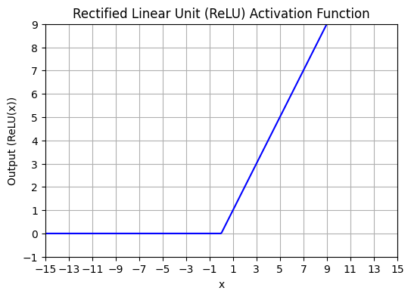
Filter
Filter detects:
Half circle pattern on the eyelid.
Filter detects:
Eye location
Filter
Different filters for each feature map
ReLU
ReLU
Feature map layer 1
Feature map layer 1
Pooling layer 1
Feature map layer 2
Fully Connected Layer
Pooling
layer 2
Feature map layer 3
ReLU
Feature map layer 3
Flatten (each pixel is an input node)
.
.
.
Cat
Pooling
layer 3
Dog
Feature map layer 2
Filter detects:
Multiple objects, associating the animal to be a dog.
Filter

Slide 73

Class | Month | Year | Daily_price
SUV | 2 | 2024 | 44
Luxury | 2 | 2022 | 70
Sedan | 2 | 2017 | 18
Truck | 2 | 2019 | 33
Truck | 2 | 2018 | 31
Class | Month | Year | Daily_price | Predicted
SUV | 2 | 2024 | 44 | 41
Luxury | 2 | 2022 | 70 | 41
Sedan | 2 | 2017 | 18 | 41
Truck | 2 | 2019 | 33 | 41
Truck | 2 | 2018 | 31 | 41
Average(Daily_price)
Residual(Actual – Predicted)
Run the data through the decision tree
Class | Month | Year | Daily_price | Predicted | Residual
SUV | 2 | 2024 | 44 | 41 | 3
Luxury | 2 | 2022 | 70 | 41 | 29
Sedan | 2 | 2017 | 18 | 41 | -23
Truck | 2 | 2019 | 33 | 41 | -8
Truck | 2 | 2018 | 31 | 41 | -10
*Learning Rate (0.1)
+ Predicted Value (Average)
-9
-23
3
29
Output is multiplied by Learning Rate
avg(-8,- 10)
Smaller
Predicts Residual Value
Create and train a decision tree
= New predicted values
Calculate new residuals
Class | Month | Year | Daily_price | Predicted | Residual | New_residual
SUV | 2 | 2024 | 44 | 41 | 3 | 2.7
Luxury | 2 | 2022 | 70 | 41 | 29 | 26.1
Sedan | 2 | 2017 | 18 | 41 | -23 | -20.7
Truck | 2 | 2019 | 33 | 41 | -8 | 0.9
Truck | 2 | 2018 | 31 | 41 | -10 | 0.9
41.3
43.9
38.7
32.1
30.1
44
70
18
33
31
41.3
43.9
38.7
32.1
30.1
2.7
26.1
-20.7
0.9
0.9
-
=

Slide 74
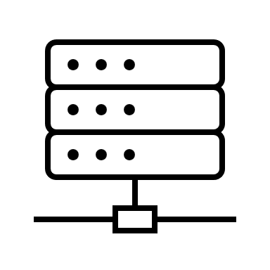
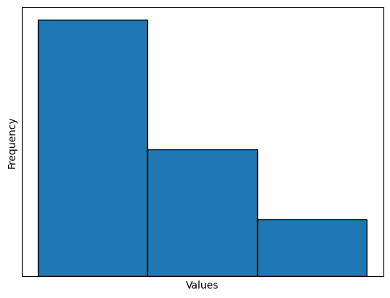
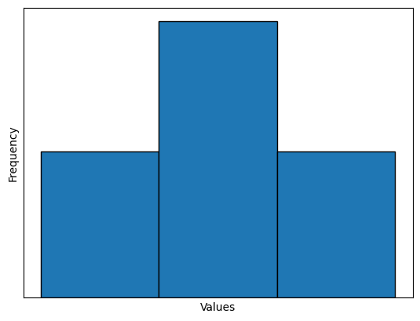
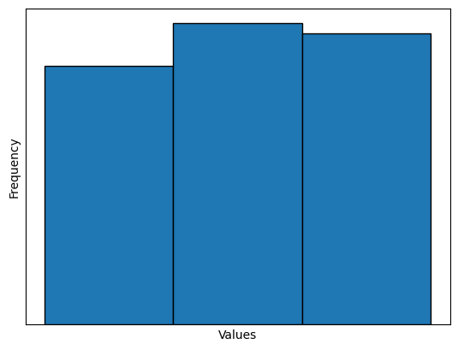
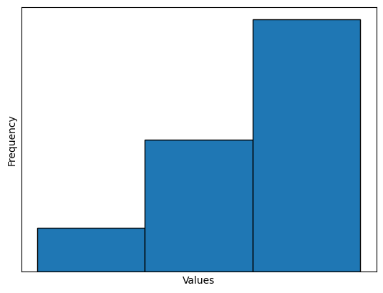
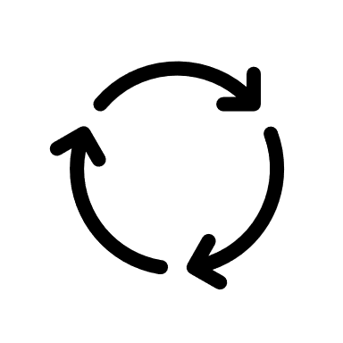
Different feature
…
…
…
…
Summarized histograms
Find the best split point among all features
G1
G3
G4
G6
G7
G8
G9
G11
G12
G13
G14
G15
G16
G17
G2
G10
Run data through the model to predict its residual
Redo this process until a tree is made.
Residual *eta
+predicted value
New prediction and new residual
Residuals minimized
Create a new tree
Repeat the process in making trees

Slide 75

.
.
.
Picks the best base stump via calculations.
w₁
w₂
w₃

Slide 76

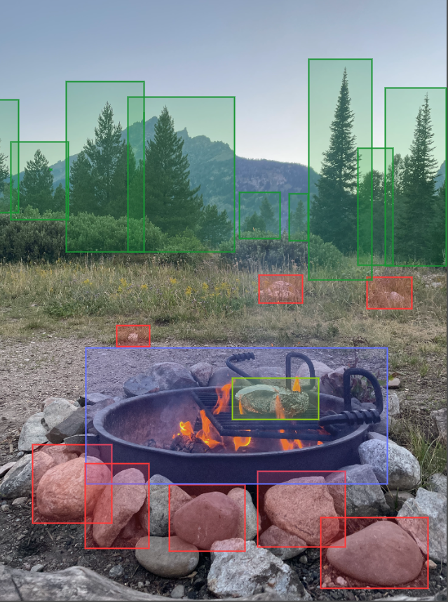
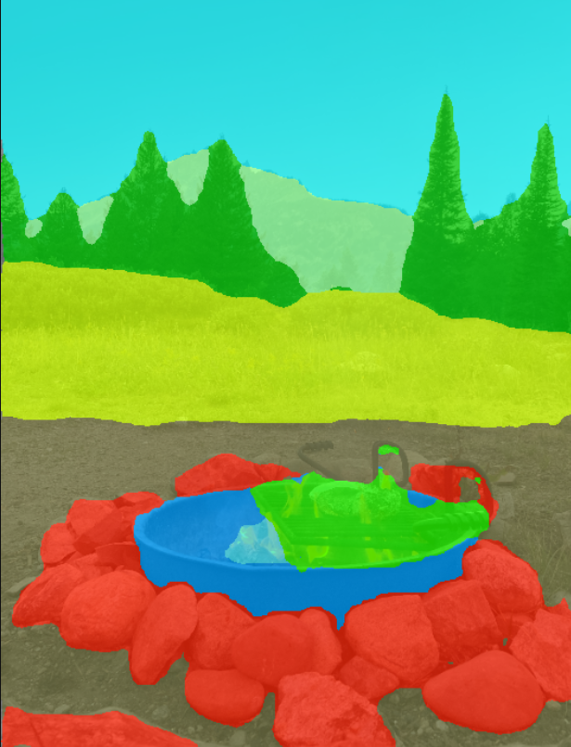
Original photo
Classifies whether this is nature or not. In this case, it classifies it as nature.
Image Classification
Object Detection
Semantic Segmentation

Slide 77
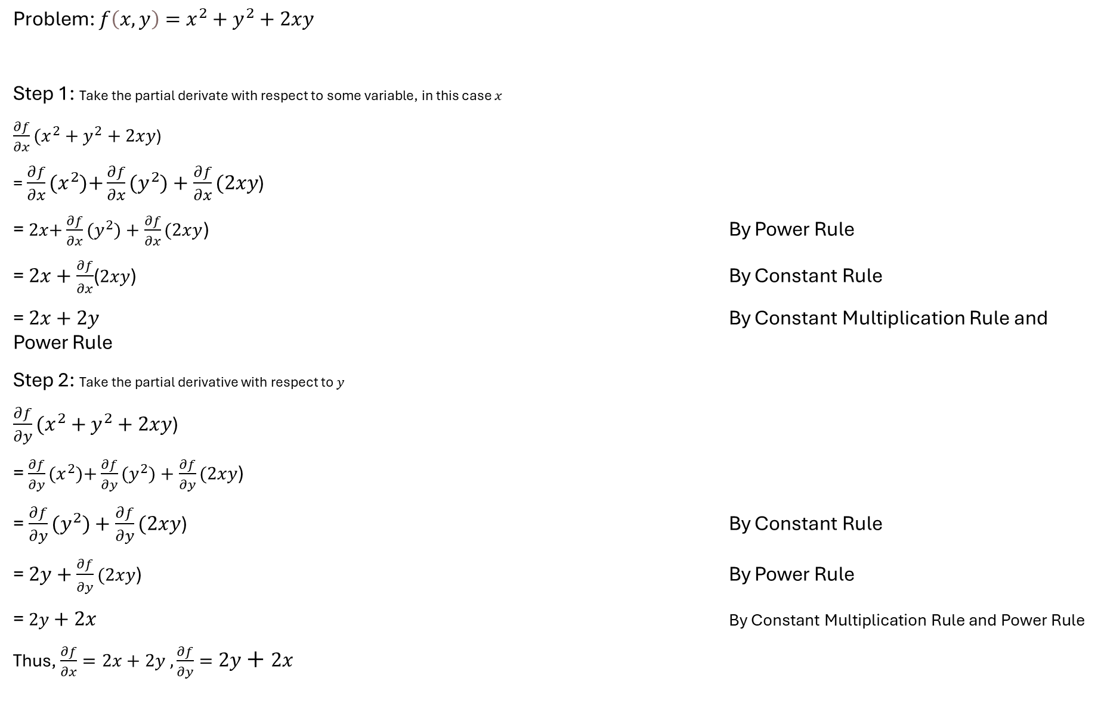
Problem: $f\left(x,y\right)=x^{2}+y^{2}+2xy$
Step 1: Take the partial derivate with respect to some variable, in this case $x$
$\frac{∂f}{∂x}(x^{2}+y^{2}+2xy$)
= $\frac{∂f}{∂x}(x^{2}){+\frac{∂f}{∂x}(y}^{2})+\frac{∂f}{∂x}(2xy$)
= $2x{+\frac{∂f}{∂x}(y}^{2})+\frac{∂f}{∂x}(2xy$) By Power Rule
= $2x+\frac{∂f}{∂x}$($2xy$) By Constant Rule
= $2x+2y$ By Constant Multiplication Rule and Power Rule
Step 2: Take the partial derivative with respect to $y$
$\frac{∂f}{∂y}(x^{2}+y^{2}+2xy$)
= $\frac{∂f}{∂y}(x^{2}){+\frac{∂f}{∂y}(y}^{2})+\frac{∂f}{∂y}(2xy$)
= ${\frac{∂f}{∂y}(y}^{2})+\frac{∂f}{∂y}(2xy$) By Constant Rule
= $2y+\frac{∂f}{∂y}(2xy$) By Power Rule
=$2y+2x$ By Constant Multiplication Rule and Power Rule
Thus, $\frac{∂f}{∂x}=2x+2y , \frac{∂f}{∂y}=2y+2x$

Slide 78
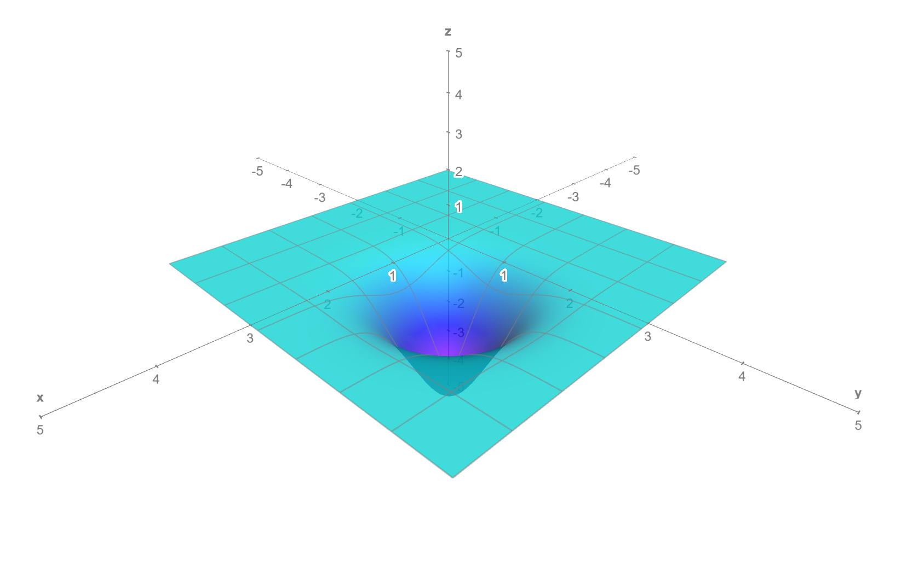

Slide 79
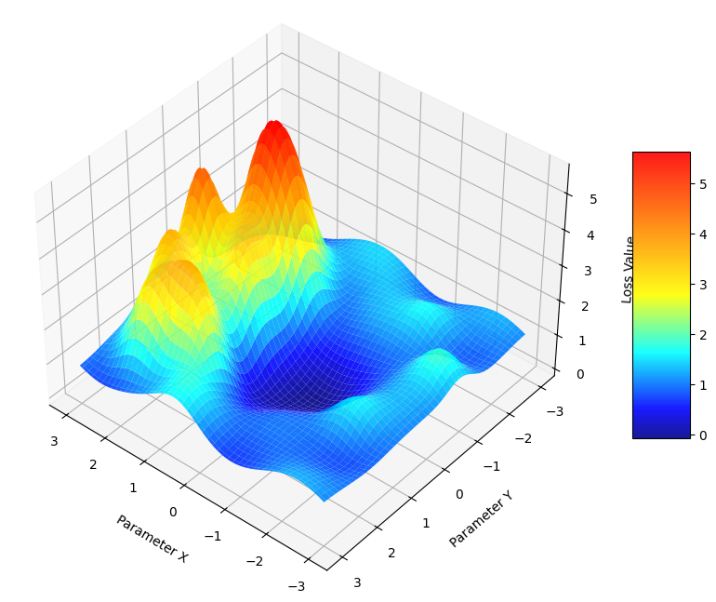

Slide 80


Book
LinkedIn

Slide 81
Thank you
I wish you the best on your journey to greatness

